Slide 1
FY 2024 Funding Outlook for Social & Behavioral Science
March 16, 2023
Wendy Naus, Executive Director

Slide 2
Today’s Discussion
Current Funding for Social and Behavioral Science Research
Preview of President Biden’s FY 2024 Budget Request
What’s Next
What You Can Do

Slide 3
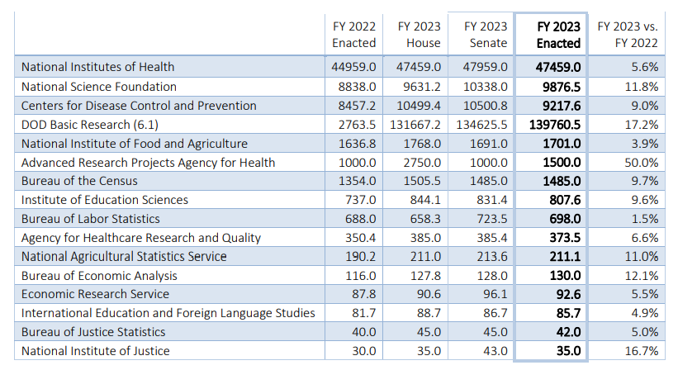
FY 2023 Recap

Slide 4
FY 2023—National Institutes of Health
$2.5B increase to the NIH base budget.
At least 3.8% increase to ICs.
Includes 4th year of firearm injury research funding ($12.5M)
Does not fund Sexual Orientation and Gender Identity Research Center
Appropriation does not include funding for ARPA-H (provided separately in HHS budget) - $1.5B

Slide 5
FY 2023—National Science Foundation
More than $1B increase, BUT
  All provided through emergency funding
  Without supplemental, NSF budget would be flat in FY 2023
New TIP Directorate prioritized

Slide 6
FY 2023—Justice
Apparent sizable increases in FY 2023, BUT…
  Still recovering from big cuts taken in previous years.
  NIJ funding includes several unfunded Congressional mandates, reducing NIJ’s base down to $21.3M.

Slide 7
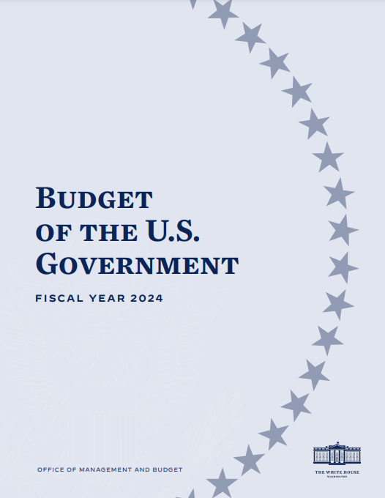

Slide 8
FY 2024 Budget Highlights
Biden Administration is boasting a $209.7 billion budget for R&D in FY 2024 (+$8.9 billion).
Priorities include:
  Cutting the cancer death rate by at least 50 percent over 25 years
  Preparing for and preventing future pandemics
  Combating climate change
  Addressing national security and technological competitiveness.

Slide 9
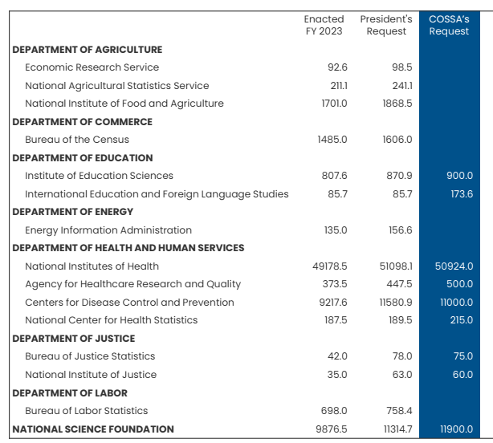

Slide 10
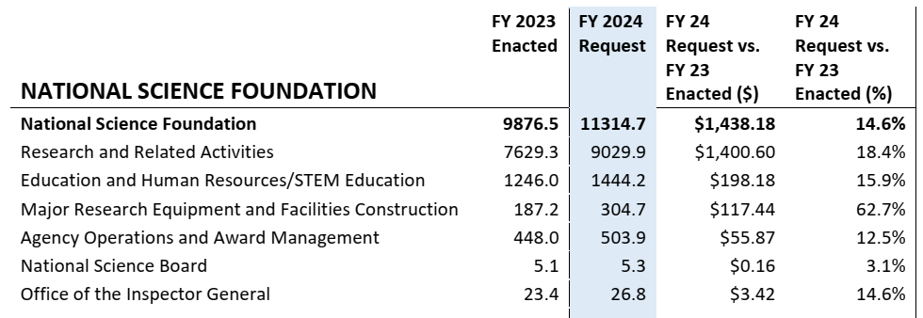
National Science Foundation

Slide 11
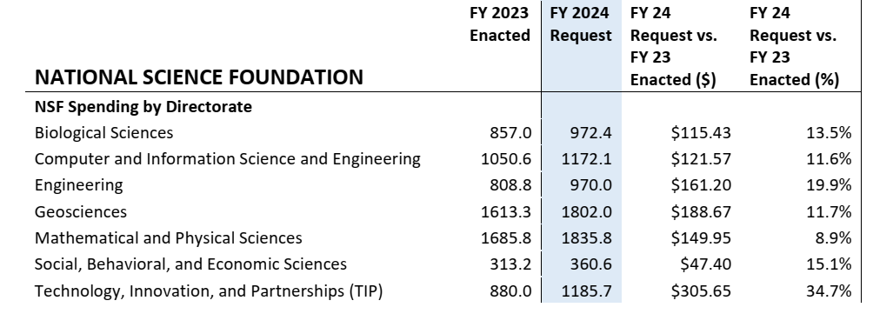
NSF (cont.)

Slide 12
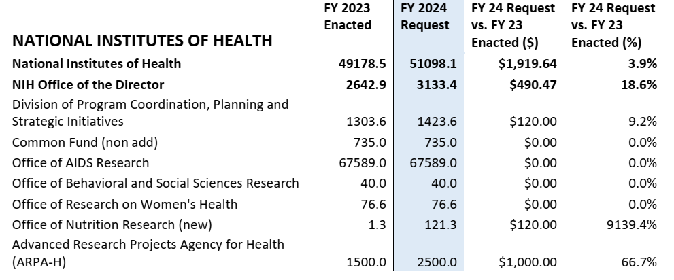
National Institutes of Health

Slide 13
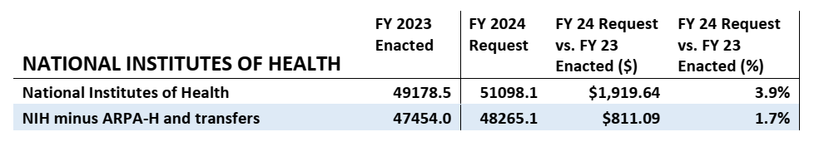
National Institutes of Health

Slide 14
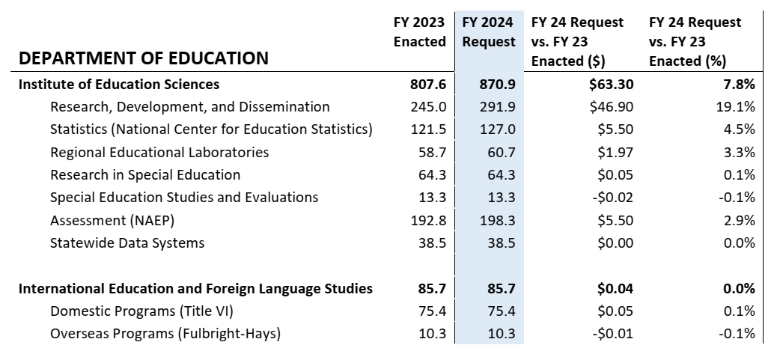
Department of Education

Slide 15
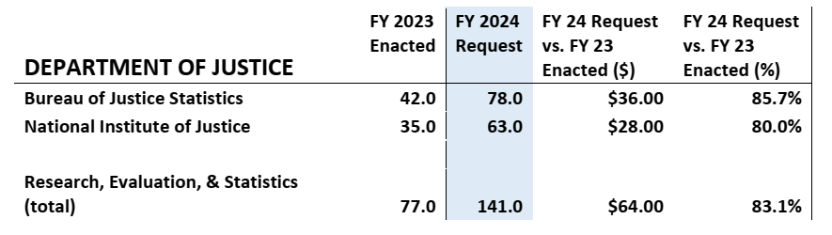
Department of Justice

Slide 16
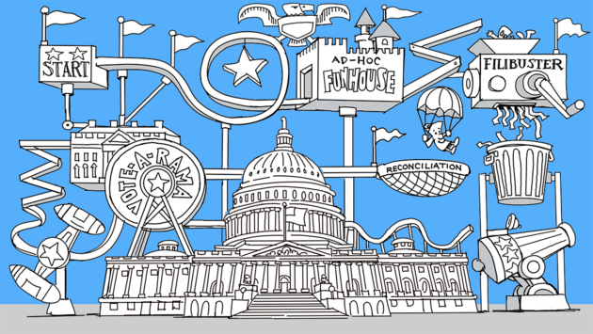
What’s Next
Congressional hearings underway.
Funding priorities being accepted/submitted.
Advocacy groups setting goals and strategies.

Slide 17
What’s Next
Congressional hearings underway.
Funding priorities being accepted/submitted.
Advocacy groups setting goals and strategies.
BUT – 118th Congress has a new Republican majority

Slide 18
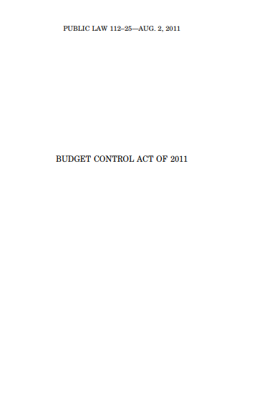
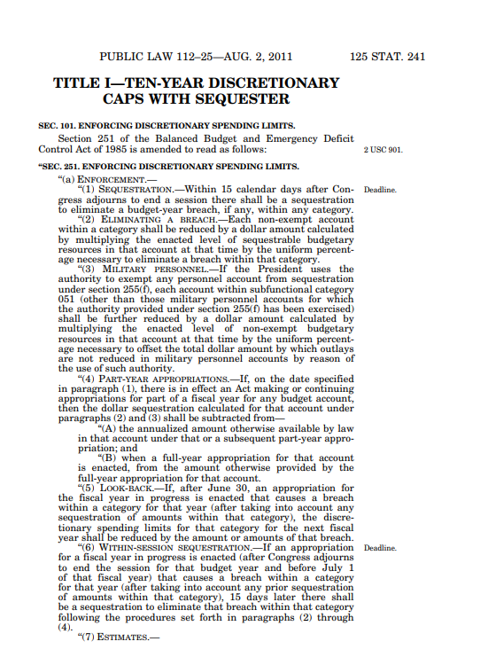

Slide 20
Return to FY 2022 Levels?

Slide 21
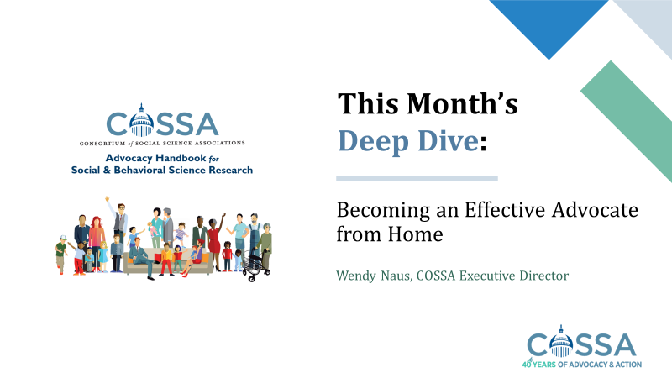
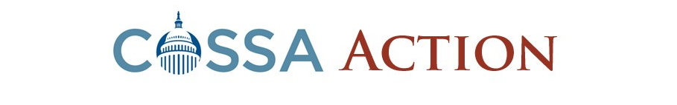
What you can do
Take action!
COSSA Action Alerts
Advocate from Home: cossa.org/event/cossa-headlines-2022-03-10/
cossa.org/action-center/alerts

Slide 22
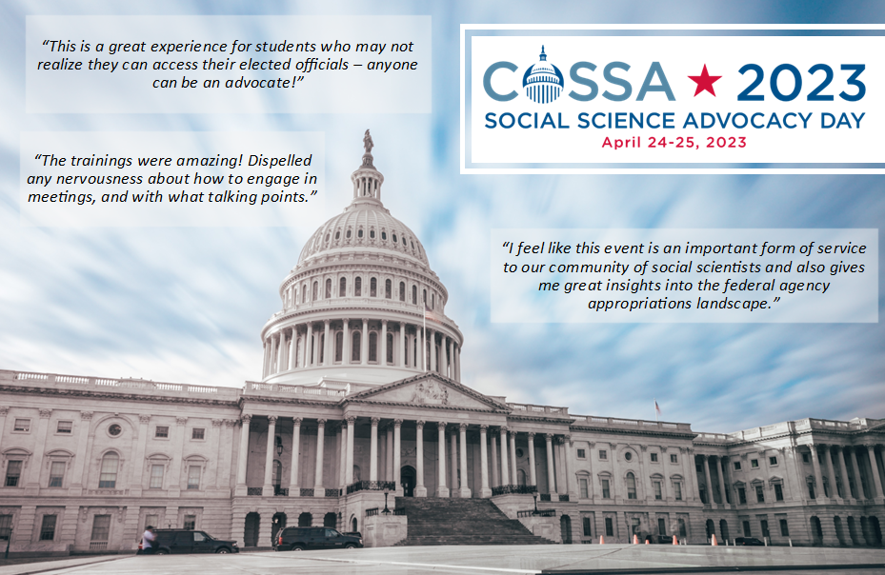
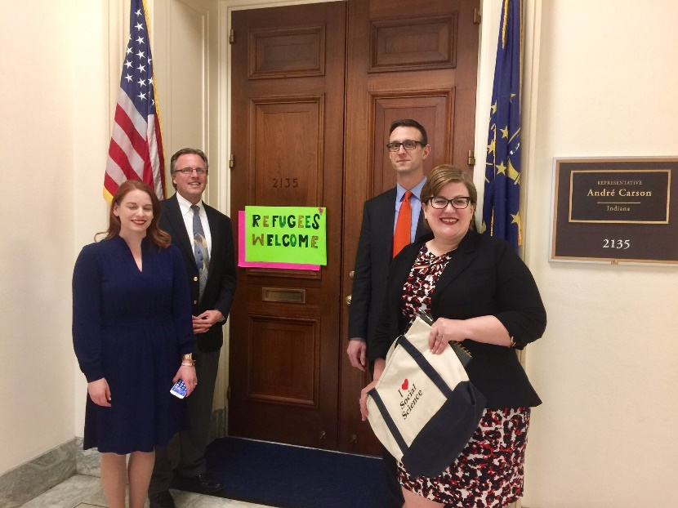
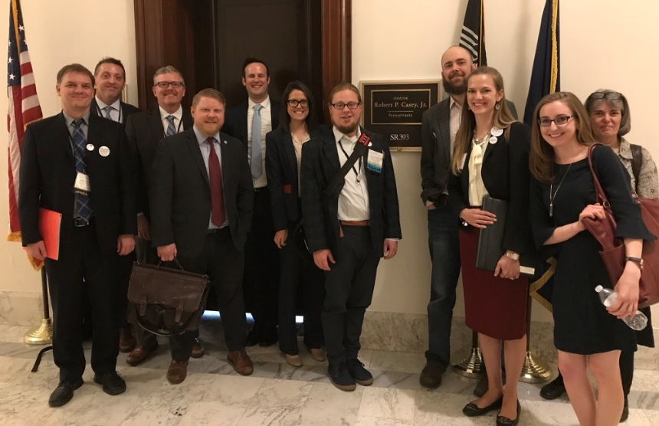

Slide 23
Join our efforts!
Wendy A. Naus
Executive Director
Consortium of Social Science Associations
wnaus@cossa.org
www.cossa.org
www.whysocialscience.com

